Slide 1
Begin Your Gardening Journey
Essential tips for starting your own garden
Notes:
AI-generated content may be incorrect. --- Starting a small garden can be a rewarding and fulfilling experience. In this presentation, we will cover essential steps and tips to help you create and maintain a small garden, whether for vegetables, flowers, or herbs.

Slide 2
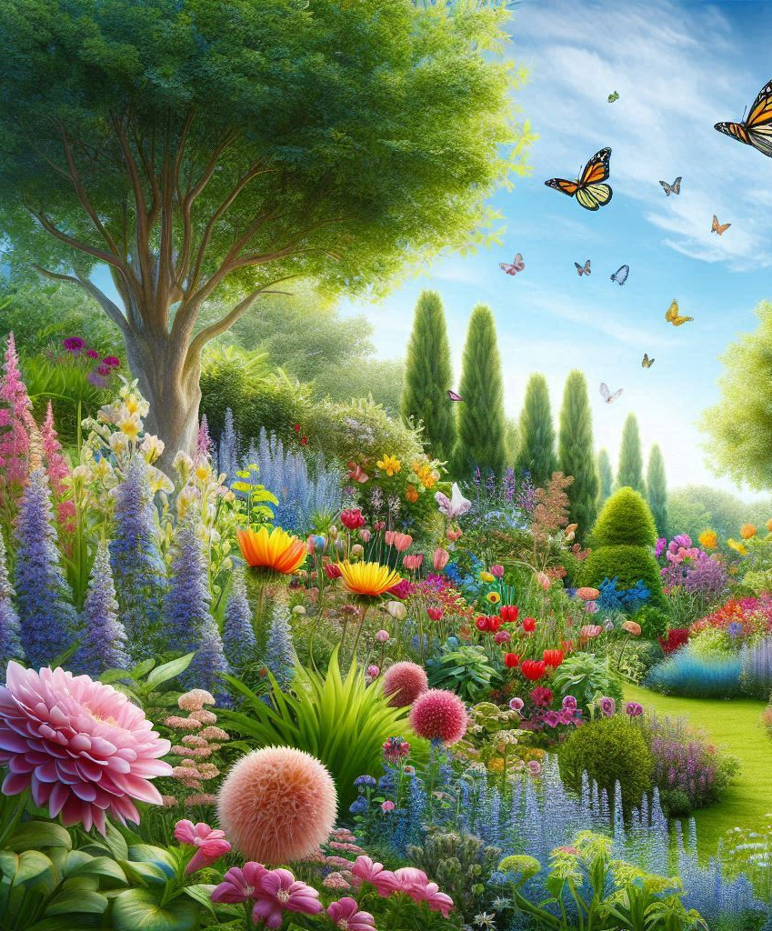
Agenda
Introduction to Gardening
Planning Your Garden Layout
Understanding Light and Soil Requirements
Choosing the Right Plants
Creating a Planting Schedule
Care and Maintenance of Your Garden

Slide 3
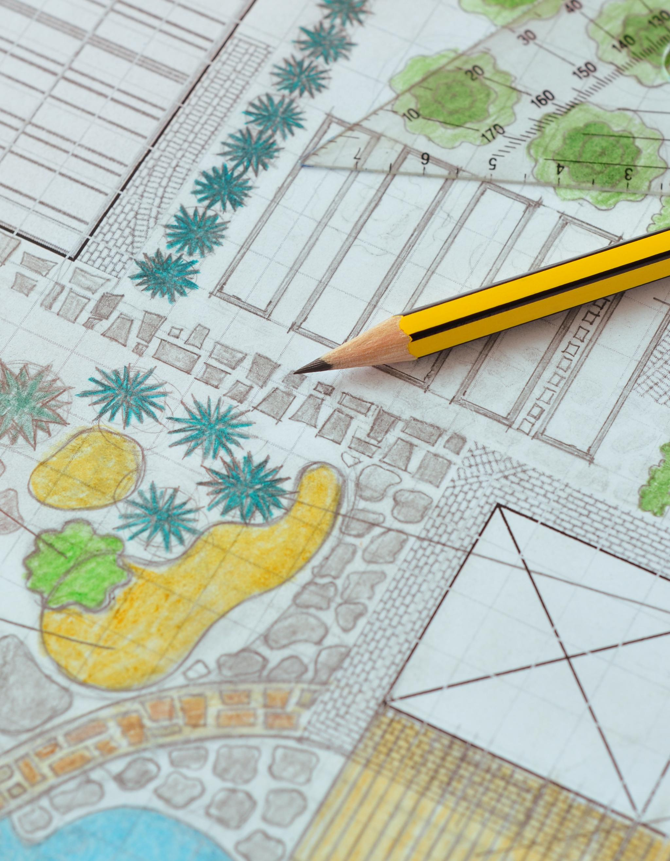
Planning Your Garden
Available Space
Assessing the available space is crucial when planning your garden layout to ensure optimal plant growth.
Sunlight Considerations
Understanding sunlight exposure is essential for selecting suitable plants and arranging them effectively in your garden.
Soil Quality
Evaluating soil quality helps in choosing the right plants and ensuring they thrive in your garden environment.
Notes:
The first step to starting a small garden is planning. An effective garden plan considers your available space, sunlight, and soil quality. Taking these factors into account will help you create a successful garden layout.

Slide 4
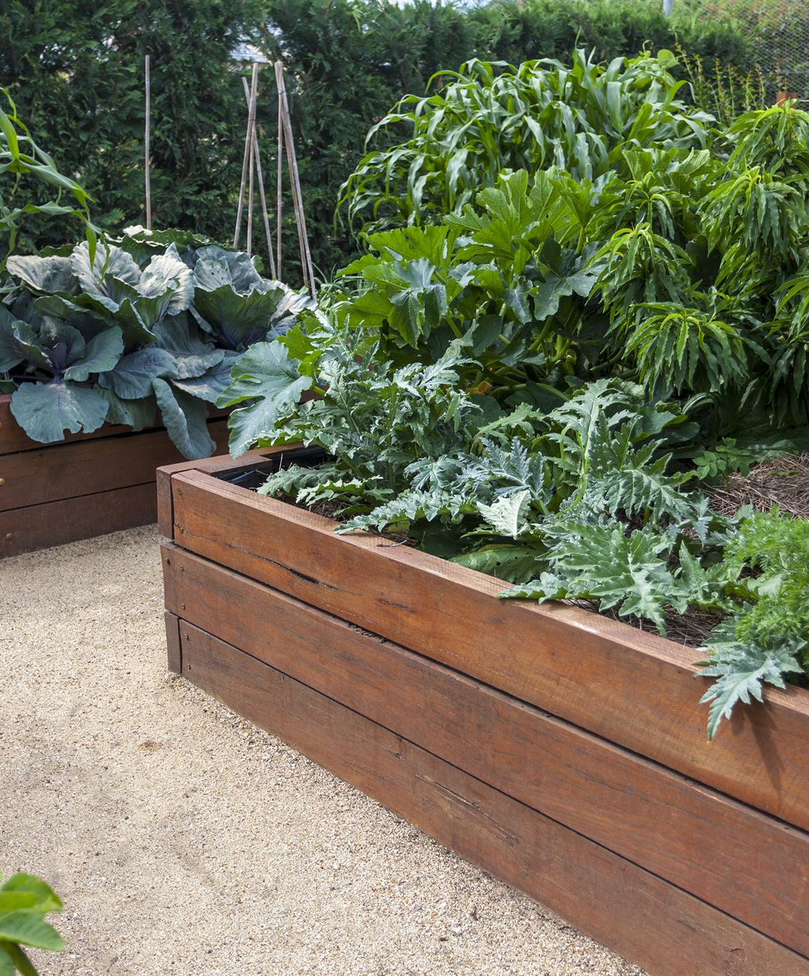
Assessing Your Space
Determine Garden Size
Start by measuring the available space for your garden to ensure a suitable design. Knowing the size helps in planning effectively.
Choose Planting Method
Decide whether to use containers, raised beds, or direct planting based on your space and gardening preferences.
Sketch Garden Design
Create a sketch of your garden layout to visualize the arrangement of plants and components before planting.
Notes:
Begin by determining the size of the area you have available for your garden. Consider whether you want to use containers, raised beds, or direct planting in the ground. Take measurements and sketch out your garden design to visualize the layout.

Slide 5
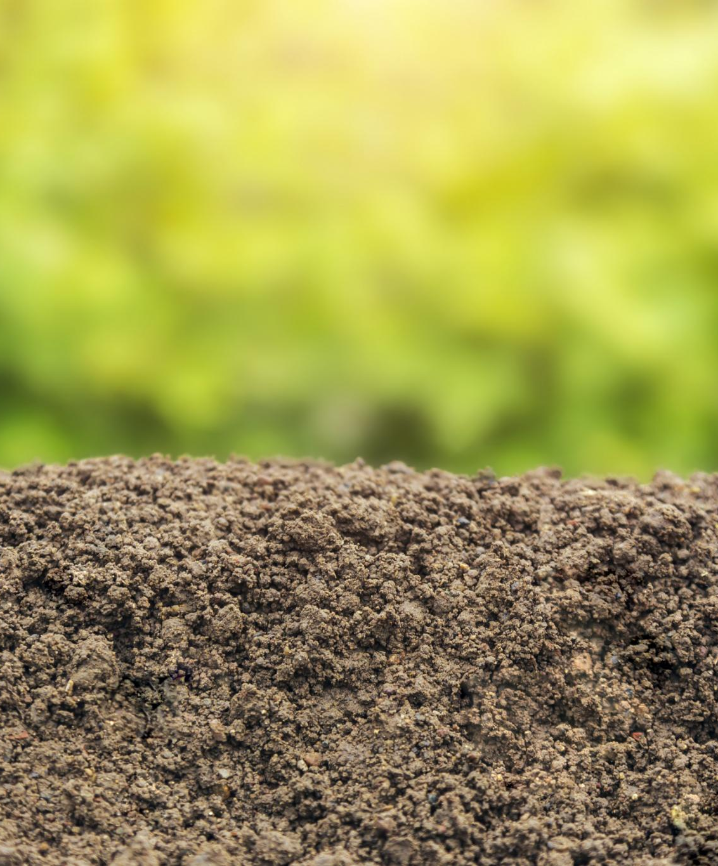
Understanding Light and Soil
Sunlight Assessment
Evaluate the sunlight your gardening area receives daily, as most plants need at least six hours for optimal growth.
Soil Quality Testing
Testing soil quality is essential to ensure it is nutrient-rich and well-draining, crucial for healthy plant development.
Plant Growth Requirements
Understanding the light and soil requirements is vital for successful and vibrant plant growth in your garden.
Notes:
Assess the amount of sunlight your gardening area receives throughout the day. Most plants require at least six hours of sunlight. Additionally, test the soil quality to ensure it’s rich in nutrients and well-draining, which is vital for plant growth.

Slide 6
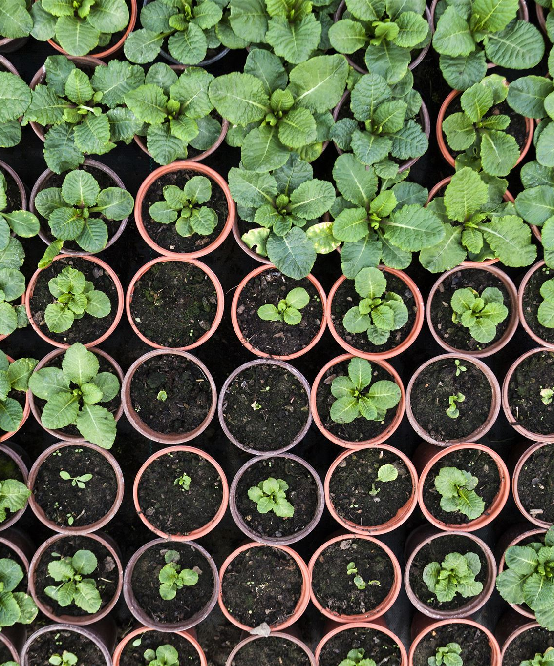
Choosing the Perfect Plants for Beginners
Start with easy-to-grow plants like herbs and vegetables.
Consider the climate and season when selecting plants.
Opt for native plants that are well-suited to your environment.
Notes:
Selecting the right plants is crucial for beginner gardeners to succeed. Starting with easy-to-grow options like herbs and vegetables helps build confidence. It's also important to consider the local climate and seasonal conditions, as well as choosing native plants that thrive in the local environment. These choices will help ensure a successful and enjoyable gardening experience.

Slide 7
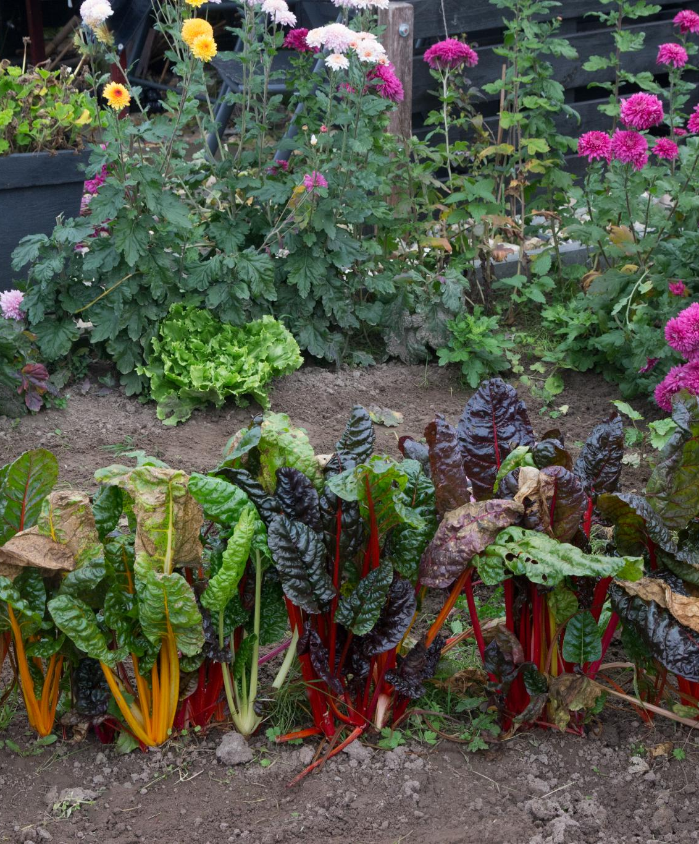
Creating a Planting Schedule
Optimal Planting Times
Understanding the best planting times for different plants ensures they thrive and yield better produce.
Staggered Planting
Staggering planting times allows for a continuous harvest, maximizing the use of garden space throughout the season.
Garden Growth Optimization
A well-planned planting schedule optimizes growth conditions, leading to healthier plants and better yields.
Notes:
Develop a planting schedule to optimize your garden's growth. Take into account the best planting times for each type of plant and stagger planting to ensure a continuous harvest throughout the growing season.

Slide 8
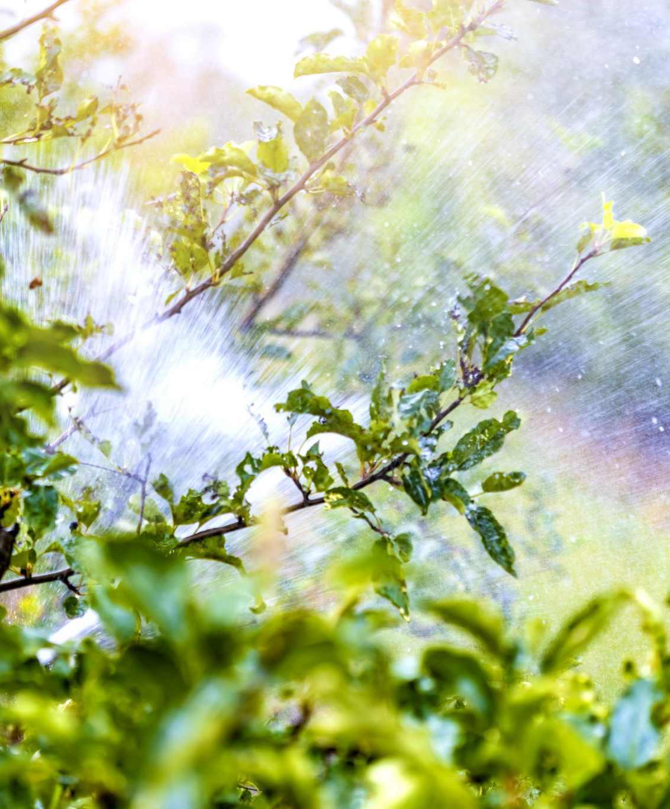
Garden Care and Maintenance
Importance of Watering
Regular watering is crucial for plant health, ensuring they receive the moisture needed for growth and productivity.
Fertilizing Techniques
Applying fertilizer helps replenish nutrients in the soil, promoting vigorous plant growth and improving yields.
Pest Management
Effective pest management is essential to protect plants from damage, using natural or chemical methods as needed.
Notes:
Once your garden is planted, ongoing care is essential for its success. Regular maintenance will keep your plants healthy and productive. This section covers watering, fertilizing, and managing pests.

Slide 9
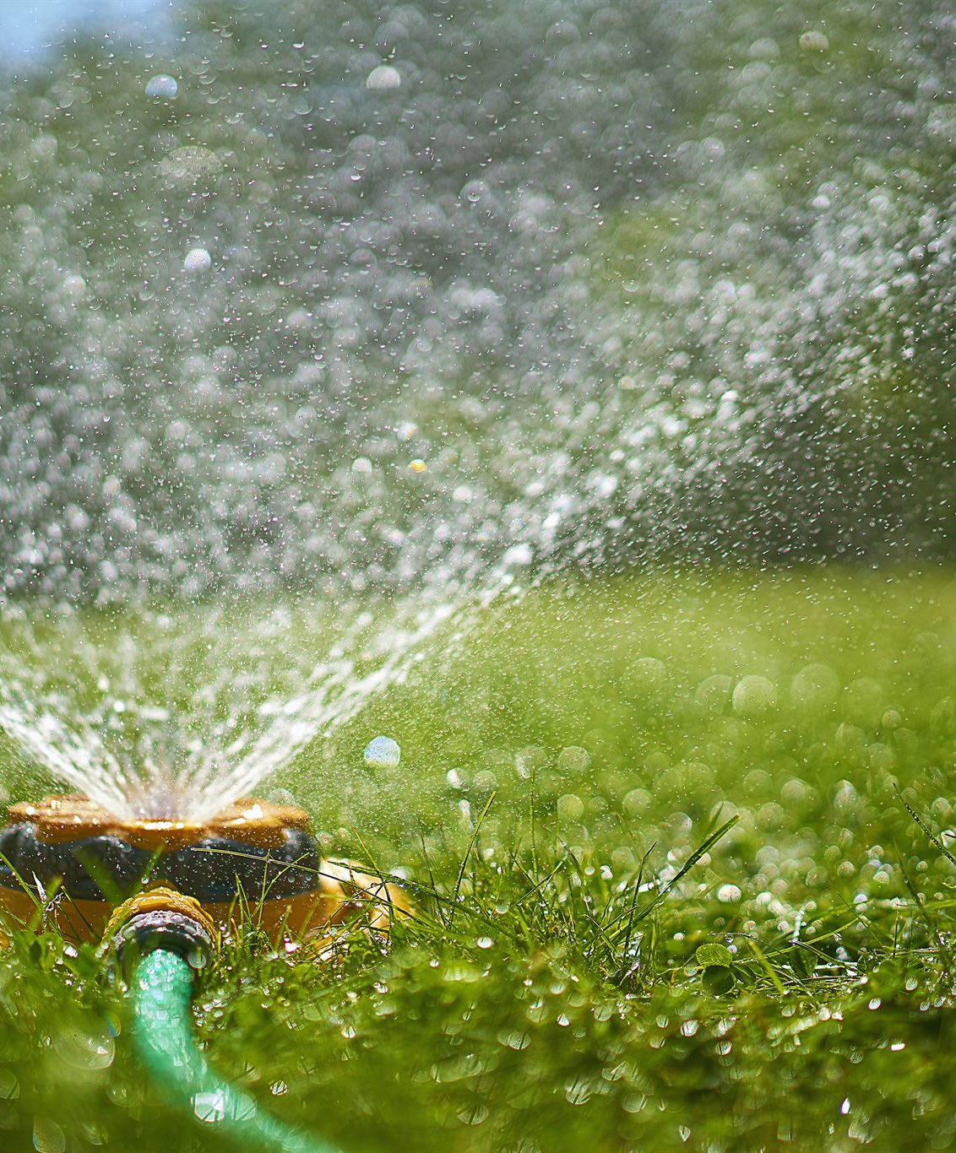
Watering Techniques
Timing for Watering
Watering early in the morning or late in the afternoon reduces evaporation and promotes better plant health.
Water Conservation Techniques
Using drip irrigation or soaker hoses conserves water and delivers moisture directly to the plant roots efficiently.
Healthy Garden Practices
Implementing proper watering techniques is essential for maintaining a healthy and thriving garden.
Notes:
Proper watering is fundamental for garden health. Water your plants early in the morning or late in the afternoon to prevent evaporation. Use techniques such as drip irrigation or soaker hoses to conserve water and deliver moisture directly to the roots.

Slide 10
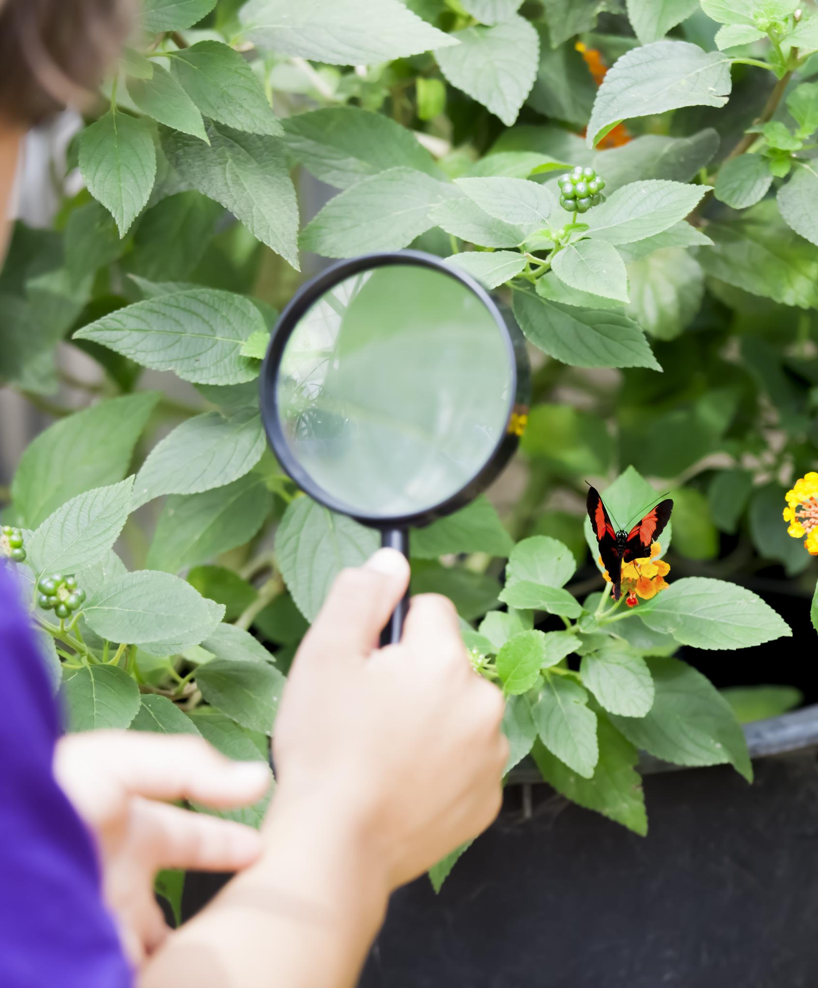
Pest Control and Troubleshooting
Monitoring Plants
Regularly check your plants for any signs of pests or diseases to catch issues early and prevent damage.
Organic Pest Control
Utilize organic methods like introducing beneficial insects or using natural repellents to manage pests sustainably.
Identifying Common Problems
Familiarize yourself with common garden problems to maintain a healthy garden and effectively address issues.
Notes:
Monitor your plants for signs of pests or diseases. Use organic pest control methods, such as introducing beneficial insects or using natural repellents. Knowing how to identify common problems will help you maintain a healthy garden.

